Slide 1
Literature Part2
報告者：陳政岳

Slide 2
Literature
Black and Cox (1976)
Leland (1994)
Leland and Toft (1996)

Slide 3

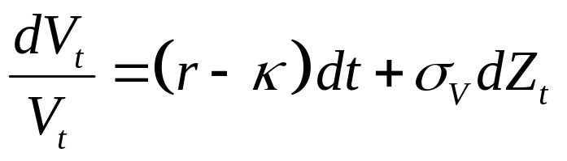



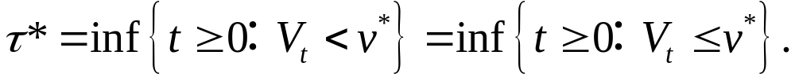
Black and Cox Approach
Black and Cox simplicity assume that it is a consol bond, which pays continuously coupon rate c. Assume that r > 0 and the payout rate is equal to zero in
：a critical level of the value of the firm, below which no more equity can be sold.
：fixed bankruptcy level.
：the optimal default time,

Slide 4
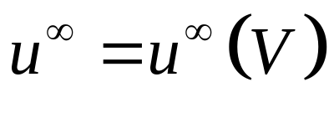
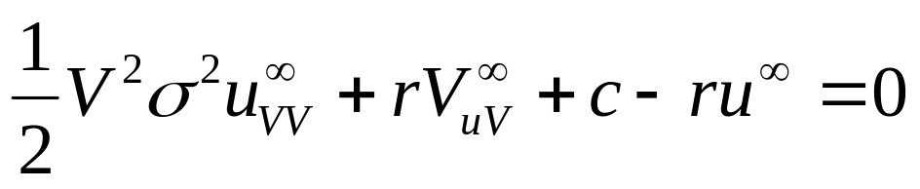
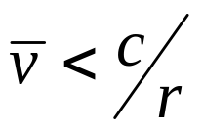
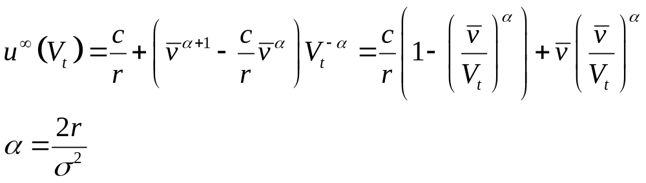
Black and Cox Approach (cont.)
By ODE for the pricing function
of a consol bond：
If

Slide 5
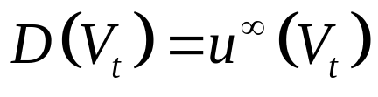
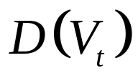
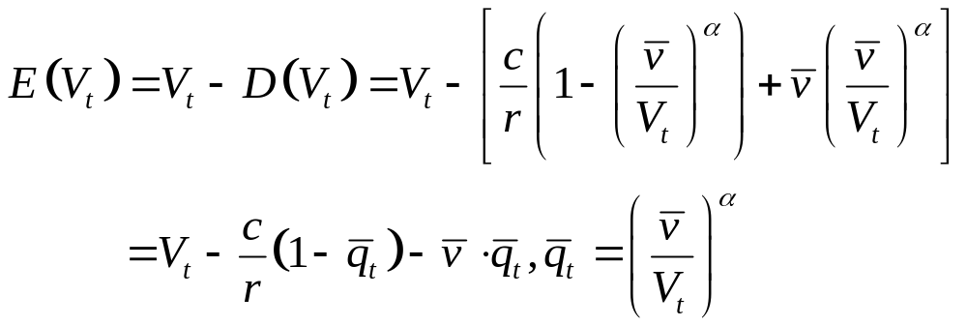
Black and Cox Approach (cont.)
It is the interest of the stockholders to select the bankruptcy level in such a way that the value of the debt,
is minimized.
the value of the firm’s equity is maximized.

Slide 6
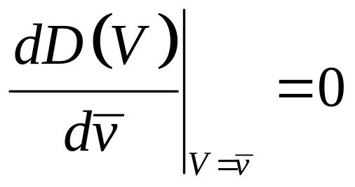
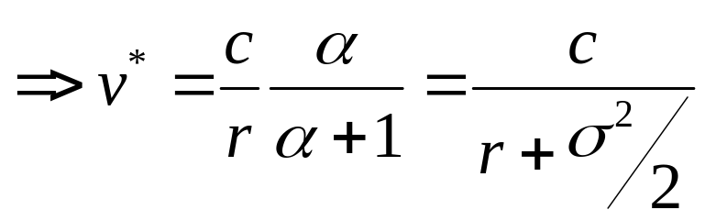
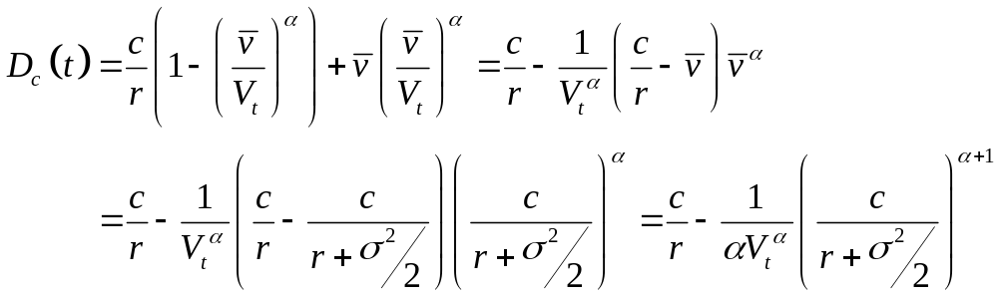
Black and Cox Approach (cont.)
Solving

Slide 7
Leland’s Approach
基本假設如 Black and Cox Approach.
增加了Bankruptcy costs 和 Tax benefits.

Slide 8

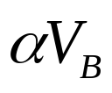

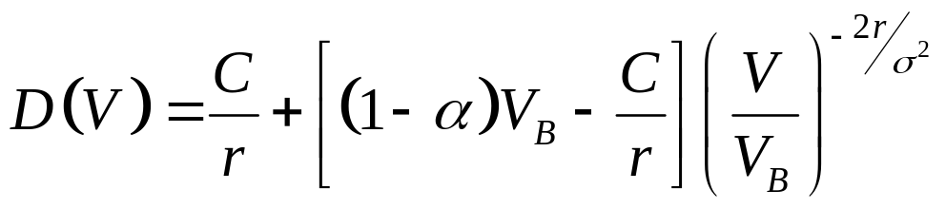
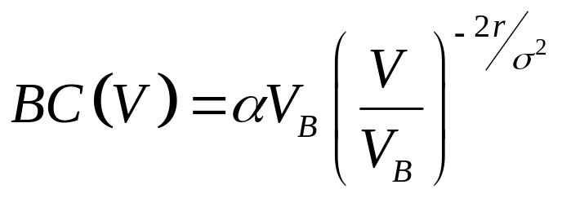
Leland’s Approach
:the level of asset value which bankruptcy is declared.
:bankruptcy cost, .
By solving ODE, we get
(7)
(9)

Slide 9
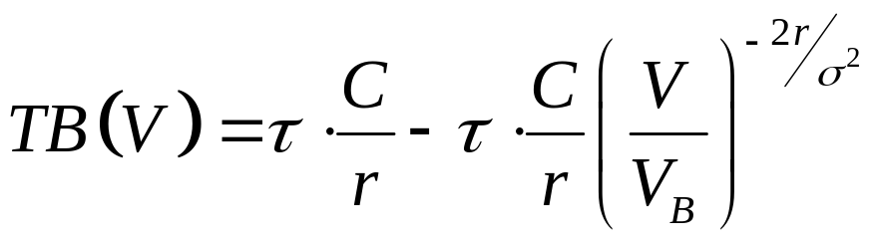
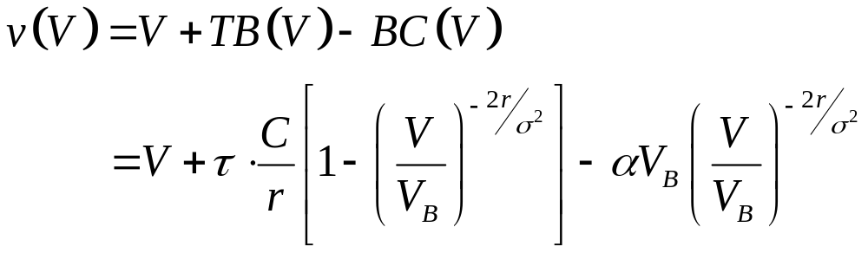
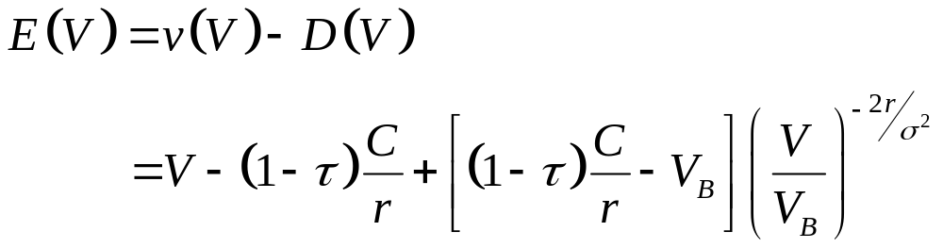
Leland’s Approach
(11)
(12)
(13)

Slide 10

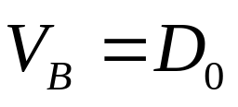
Leland’s Approach (cont.)
Unprotected debt:
Assumed that the bankruptcy occurs, the value of the equity may hit zero.
Equity can choose any barrier.
Protected debt:
Assumed that the bankruptcy occurs, the value of the is
Protected versus Unprotected Debt: Potential Agency Problems

Slide 11
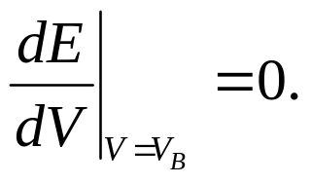
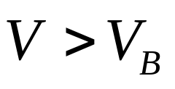
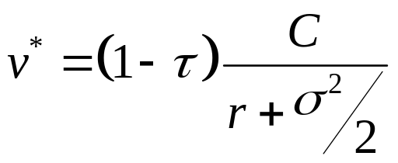
Unprotected Debt
The bankruptcy occurs whenever the value of the equity hits barrier, no matter what is the chosen level of the default triggering barrier.
It is the interest of the stockholders to select the bankruptcy level in such a way that the value of the debt is minimized, and thus the value of the firm’s equity is maximized.
Assumed is such that
Solving (14)

Slide 12
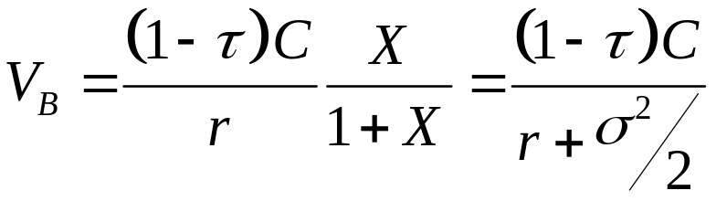



Unprotected Debt (cont.)
Observe that the asset value
a) is proportional to the coupon C;
b) is independent of the current asset value, V;
c) decreases as the corporate tax rate, , increases;
d) is independent of bankruptcy costs, ;
e) decreases as the risk-free interest rate, r, rises;
f) decreases with increases in the riskiness of the firm, .

Slide 13
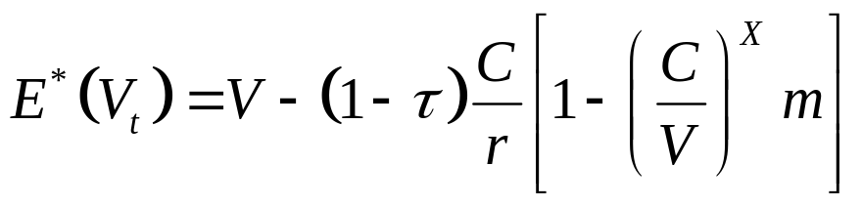
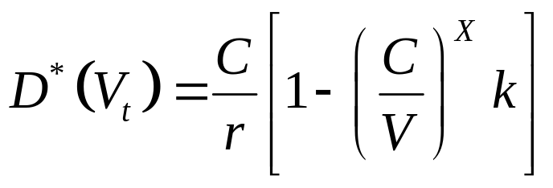
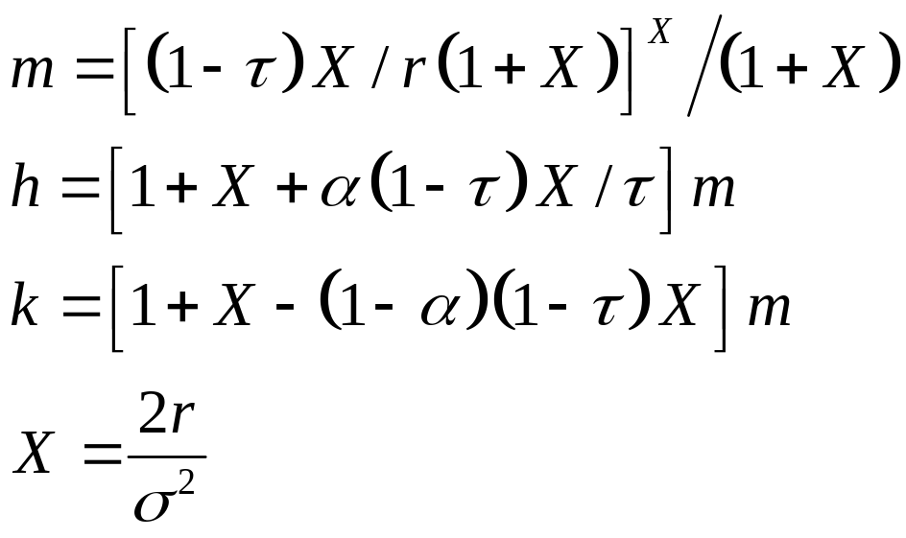
Unprotected Debt (cont.)
The maximal value of the firm’s equality is
(17)
The minimal value of the firm’s debt equals
(15).

Slide 14
Unprotected Debt (cont.)
A. The Comparative Statics of Debt Value (D(V))
B. Yield Spreads: The risk Structure of Interest Rates
C. The Comparative Statics of Firm Value (v(V)) and Equity Value (E(V))

Slide 15
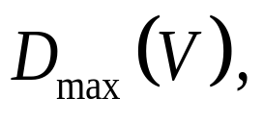
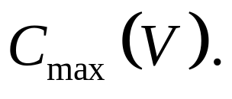
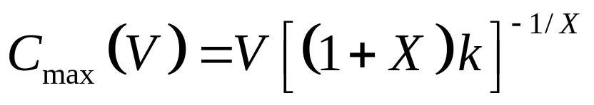
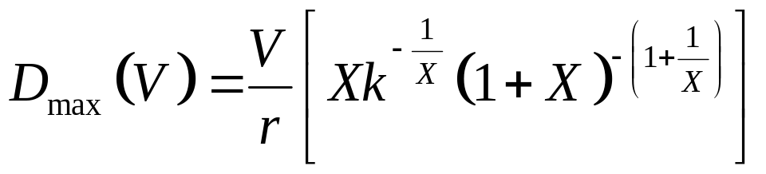
A. The Comparative Statics of Debt Value (D(V)):
D(V) is eventually decreasing as the coupon rises, implies that debt value reaches a maximum, for a finite coupon,
Differentiating equation(15) with respect to C, setting the resulting equation equal to zero and solving for C:
(19).
Substituting (19) into equation (15),

Slide 16
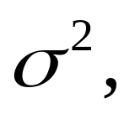


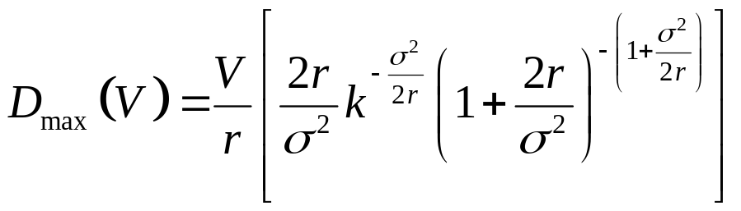
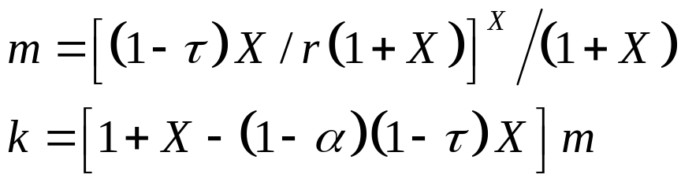
A. The Comparative Statics of Debt Value (D(V)): (cont.)
The debt capacity of a firm is proportional to asset value, V, and falls with increases in firm risk, and bankruptcy costs, Debt capacity rises with increase in the corporate tax rate, and the risk-free rate, r.

Slide 17
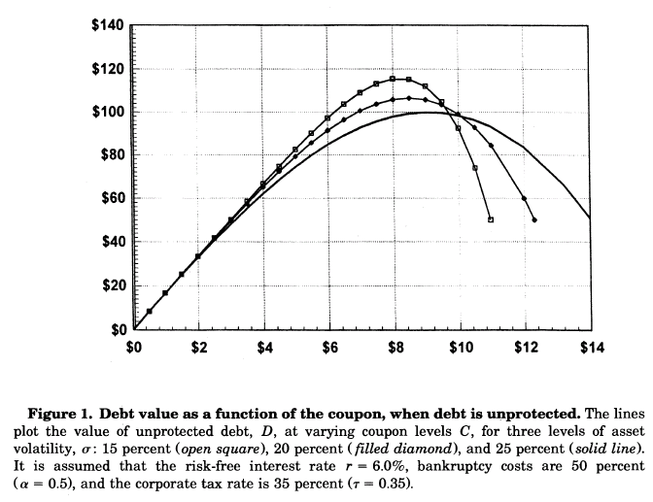
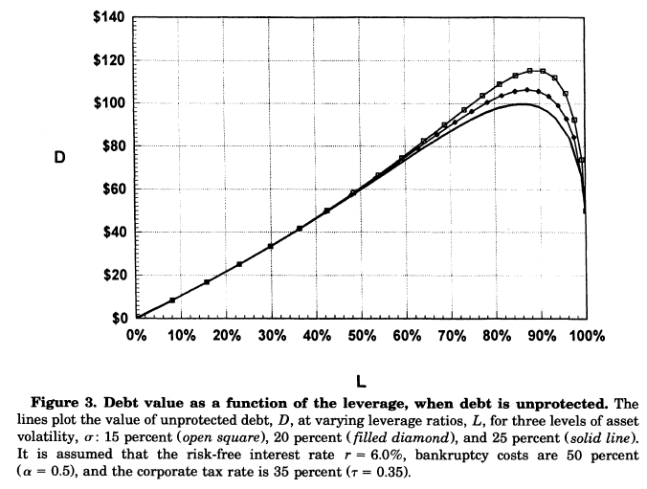
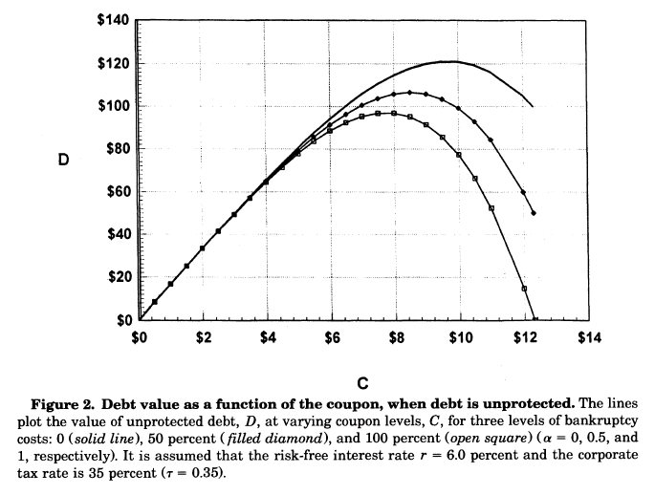
A. The Comparative Statics of Debt Value (D(V)): (cont.)

Slide 18
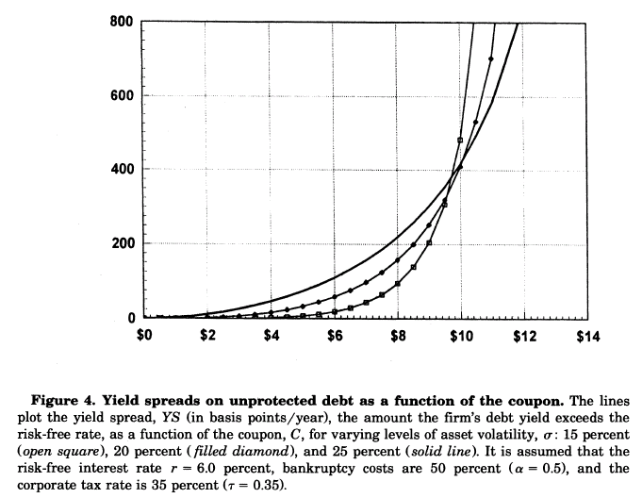
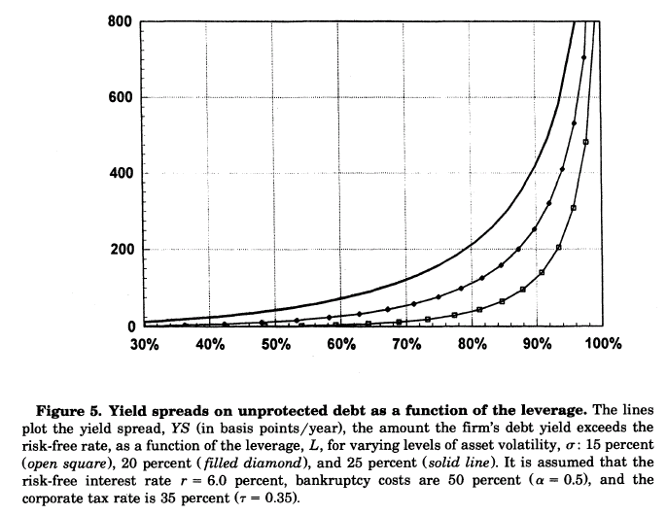
B. Yield Spreads: The risk Structure of Interest Rates
Junk bond yields spreads may actually decline when firm riskiness increases.
Investment-grade debt yield spreads increase when firm risk risk rise.

Slide 19
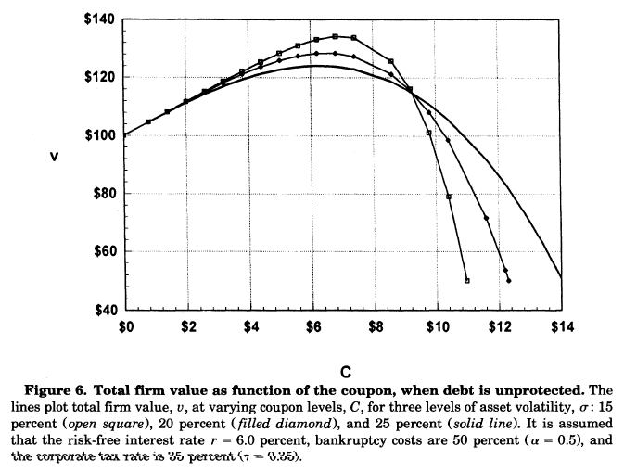
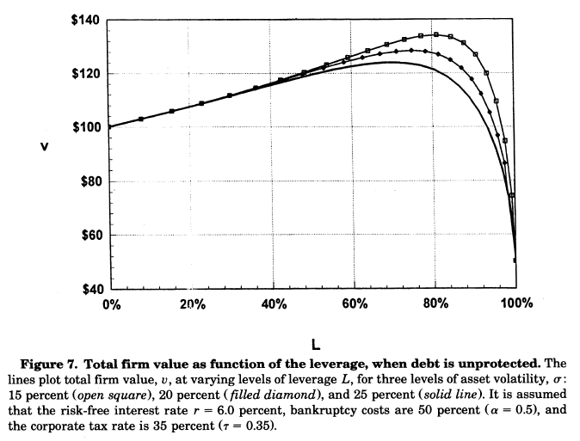
C. The Comparative Statics of Firm Value (v(V)) and Equity Value (E(V))

Slide 20
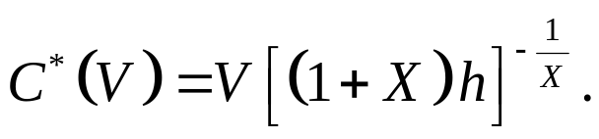
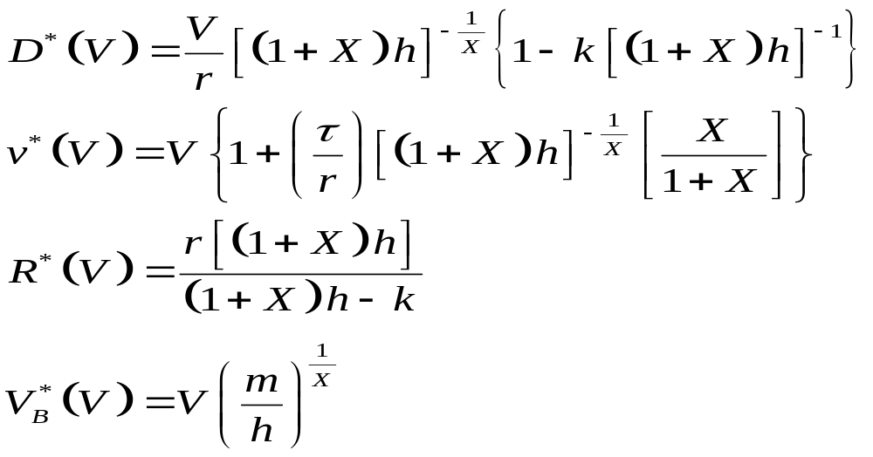
Optimal Leverage with Unprotected Debt
Consider the coupon rate, C, which maximizes the total value, v, of the firm.
Differentiation equation (16) with respect to C, setting the derivative equal to zero and solving for the optimal coupon

Slide 21
Optimal Leverage with Unprotected Debt (cont.)
The optimal leverage rations of riskier firms will always be less than those of less risky firms, as can be seen by observing the maximal firm values in Figure7.
The optimal coupon is a U-shaped function of firm riskiness, as illustrated in Figure8.

Slide 22
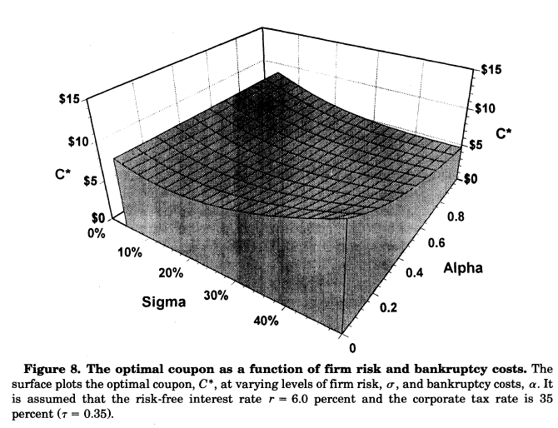
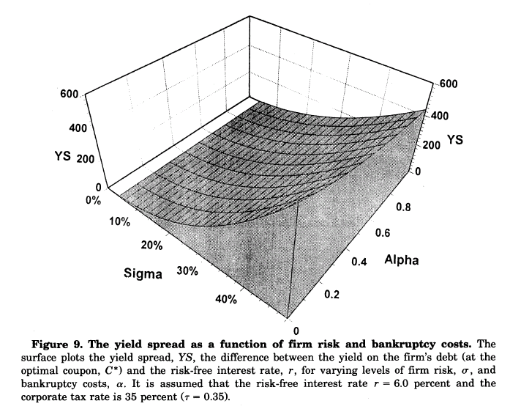
Optimal Leverage with Unprotected Debt (cont.)

Slide 23

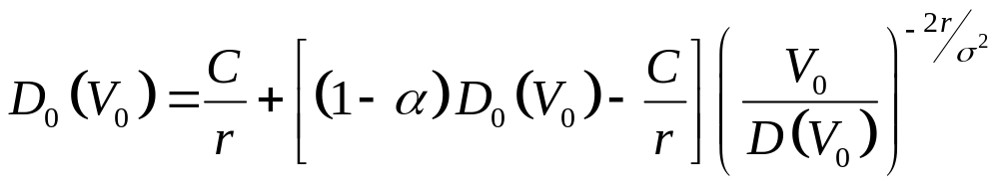

Protected Debt
P : outstanding debt when bankruptcy is triggered by the firm’s assets falling beneath the principal value of debt
: the principal coincides with the market value of the debt
From equation (7) with , we can write the value of protected debt as a function of the value of assets , :

Slide 24
Protected Debt (cont.)
Figures 10 and 11 illustrate the behavior of protected debt value as the coupon and leverage change.
Increased firm risk or a higher risk-free interest rate always lowers debt value.

Slide 25
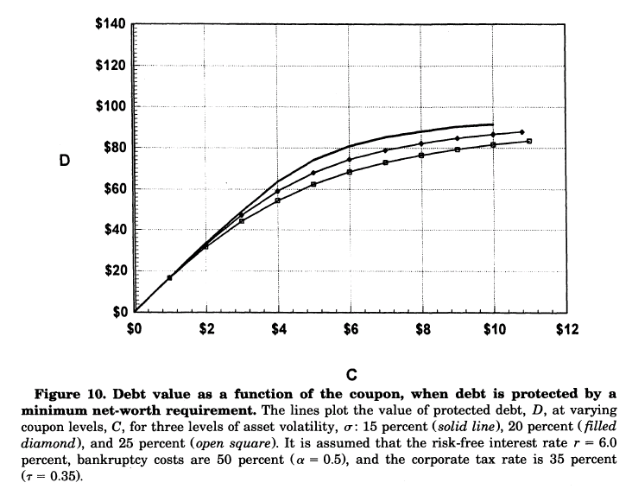
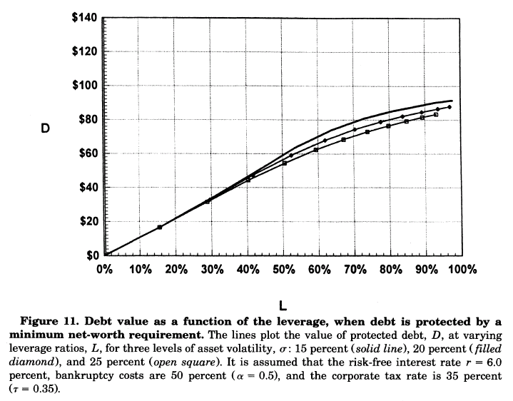
Protected Debt (cont.)

Slide 26

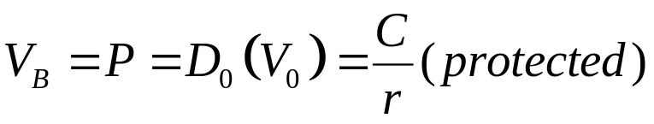
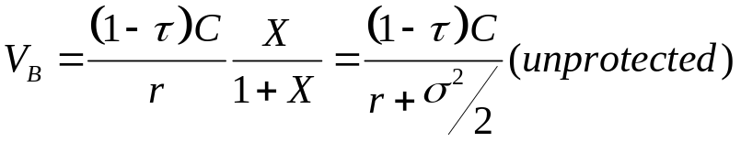
Protected Debt (cont.)
When there are no bankruptcy costs( )
a) Protected debt is riskless and pays the risk-free rate r.
b) For any C, the value of the tax shield with protected debt is less than the tax shield with unprotected debt.
c) For any C, the bankruptcy-triggering value of assets, , for protected debt excess the for unprotected debt.

Slide 27
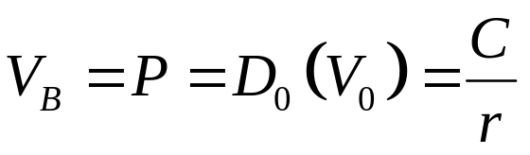
Protected Debt (cont.)
When bankruptcy costs are zero. Asset value falling to the principal value, then bankruptcy is declared and, debtholders receive their full principal value.
When bankruptcy costs exist. For a given coupon, protected debt have a lesser value than unprotected debt.

Slide 28

Optimal Leverage with Protected Debt (cont.)

Slide 29

Optimal Leverage with Protected Debt
Using a simple procedure to find the coupon, , that maximizes the total value, v, of the firm with protected debt. Figure 13, compared with Figure 7 illustrate that maximal firm value occurs at lower leverage.

Slide 30

Optimal Leverage with Protected Debt (cont.)

Slide 31
Optimal Leverage with Protected Debt (cont.)
a) Optimal leverage for protected debt is substantially less than for unprotected debt.
b) The interest rate paid at the optimum leverage is less for protected debt, even when bankruptcy costs are positive.
c) The maximum value of the firm is less when protected debt is used.
d) The maximal benefits of unprotected over protected debt increase as:
-Corporate taxes increase
-Interest rates are higher
-Bankruptcy costs are lower

Slide 32

Protected versus Unprotected Debt: Potential Agency Problems

Slide 33
Protected versus Unprotected Debt: Potential Agency Problems (cont.)
Debtholders are hurt by higher risk. In the case of unprotected debt, equity value is enhanced by greater risk.
Without covenants to prevent, it will always be in the interest of equityholders to increase risk.
But the opposite is true when debt is protected by a positive net worth covenant: in the case, increasing risk lowers equity value as well as debt value.

Slide 34



Leland and Toft Approach
As in Merton (1974), Black and Cox (1976), and Brennan and Schwartz (1978), the firm asset value V follow a continuous diffusion process
where is the total expected rate of return on asset value V; is the constant fraction of value paid out to security holders; and dz is the increment of a standard Brownian motion.

Slide 35
Leland and Toft Approach
Endogenous bankruptcy with a stationary Debt Structure
Applications

Slide 36
Endogenous bankruptcy with a stationary Debt Structure
A. A Stationary Debt Structure
B. Bankruptcy: determining the Bankruptcy -Triggering Asset Level V_{B}

Slide 37
A. A Stationary Debt Structure
Consider firm continuously sell a constant amount of new debt with maturity of T years and it will redeem at par upon maturity.
The firm remains solvent, at any time s the total outstanding debt principal have a uniform distribution in the interval (s,s+T)

Slide 38



A. A Stationary Debt Structure (cont.)
: new bond principal issued rate, and P is the total principal value of all outstanding bonds.
: coupon rate, and C is total coupon paid.
Total debt payments are time-independent and equal to

Slide 39



A. A Stationary Debt Structure (cont.)
: the total value of debt, when debt of maturity T is issued.
: bond holders receive the remaining value.
(7)

Slide 40


A. A Stationary Debt Structure (cont.)
v: the total market value of the firm, and following Leland (1994)
其中x = a + z,

Slide 41


B. Bankruptcy: determining the Bankruptcy-Triggering Asset Level V_{B}
Solving the equation ,
we can solve equation (10) for

Slide 42


B. Bankruptcy: determining the Bankruptcy-Triggering Asset Level V_{B} (cont.)
When it can be shown that as Lealnd(1994)
depend on the maturity of debt.
In contrast, the models of the with flow-based bankruptcy (Kim, Ramaswamy, and Sundaresan (1993) and Ross(1994)) or with a positive net worth covenant (Longstaff and Schwartz (1995)) is independent of debt maturity.

Slide 43



B. Bankruptcy: determining the Bankruptcy-Triggering Asset Level V_{B} (cont.)
The l.h.s. of equation (12) is the change in the equity value at
The r.h.s. is the additional cash flow required from equity holders for current debt service.
Tax deductibility is lost whenever V falls below some value

Slide 44

B. Bankruptcy: determining the Bankruptcy-Triggering Asset Level V_{B} (cont.)

Slide 45

B. Bankruptcy: determining the Bankruptcy-Triggering Asset Level V_{B} (cont.)
When in equation (13) will exceed
in equation (11).

Slide 46


Applications
Considered the loss of tax deductibility and cash flow (coupon).
When
When equity holders willingly contribute to the firm to avoid default, and a dilution of their holders resulting from stock issuance.

Slide 47
Ⅲ. Applications (cont.)
A. Optimal Leverage
B. Debt Value and Debt Capacity
C. The Term Structure of Credit Spreads

Slide 48

A. Optimal Leverage

Slide 49
A. Optimal Leverage (cont.)
Barclay and Smith (1995) find a positive correlation between leverage and debt maturity.
For any maturity, the optimal leverage ratio falls, when firm risk and bankruptcy costs increase.

Slide 50

A. Optimal Leverage (cont.)

Slide 51

B. Debt Value and Debt Capacity

Slide 52

B. Debt Value and Debt Capacity (cont.)

Slide 53
B. Debt Value and Debt Capacity (cont.)
Debt capacity falls, as debt maturity less, volatility or bankruptcy cost rise.
Low and intermediate leverages show “humped” market value: newly-issued bonds and about-to-be-redeemed bonds sell at par; bonds with remaining maturity leverage between 0 and T sell above par.
The hump is more pronounced for greater leverage levels and longer maturities.

Slide 54
B. Debt Value and Debt Capacity (cont.)
Risky bonds show a different price pattern.
while newly-issued bonds and about-to-be redeemed bonds sell at par,
bonds with short maturity sell above par,
bonds of longer maturity sell below par.
This behavior is more pronounced for longer term debt, and reflects the interplay between high coupon rates, the likelihood of bankruptcy, and time remaining to maturity.

Slide 55

C. The Term Structure of Credit Spreads

Slide 56
C. The Term Structure of Credit Spreads (cont.)
Credit spreads : high leverage levels, spreads are high, but decrease as issuance maturity T increases beyond 1 year.

Slide 57
C. The Term Structure of Credit Spreads (cont.)
A rise in the default-free rate will
increase credit spreads of shorter term debt, decrease credit spreads of long term debt.
Lower bankruptcy costs lead to the use of greater leverage for intermediate term debt, thereby increasing yield spreads for optimal debt with this maturity.

